Slide 1
Chapter 13 – Combining Methods
Data Mining for Business Analytics
Concepts, Techniques and Applications with JMP Pro
Shmueli, Bruce, Stephens & Patel
© Galit Shmueli, Peter Bruce and Mia Stephens 2016

Slide 2
Why Combine Models?
Ensemble of methods often predicts more accurately
Business goal may require multiple methods

Slide 3

The Ox Contest
“The Wisdom of Crowds”
Francis Galton, famous statistician, saw a county fair contest to judge the weight of an ox.
Individual guesses were all over the map, but the average of them all was within 1% of the ox’s true weight
For more, see The Wisdom of Crowds, by James Surowiecki

Slide 4
Ensemble methods for classification and prediction
In an ensemble approach, multiple methods are used initially, and predictions/classifications tabulated
Predicting a numeric value? Take the average of the values predicted by the various methods
Predicting a class? Take a majority vote of the classes predicted by the various methods
Predicting a propensity? Take the average of the propensities

Slide 5
Why does an ensemble make more accurate predictions?
The key is reducing the variance in predictions
Individual methods will produce predictions that have errors, some positive and some negative
If prediction methods are unbiased, on balance, errors tend to cancel each other out
An average of multiple predictions takes advantage of this canceling out and, most of the time, is more accurate than individual predictions

Slide 6
Ensemble Models in JMP Pro
Simple Model Averaging via Model Comparison
Combining predictions or classifications (e.g. voting) via the Formula Editor
Model averaging (weighted) via Stepwise in Fit Model
Bagging (Bootstrap Aggregation) via the Partition platform (Bootstrap Forest)
Boosting via both the Partition platform (Boosted Tree) and the Neural platform

Slide 7
Related forms of ensembles

Slide 8
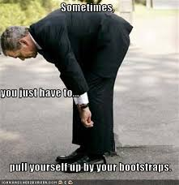
Bagging (= bootstrap aggregating)
The “multiplier” effect in bagging comes from multiple bootstrap samples, rather than multiple methods.
Bootstrapping is to take resamples, with replacement, from the original data.
Generate multiple bootstrap resamples
Run algorithm on each and produce scores
Average those scores (or take majority vote)

Slide 9
Boosting
Iteratively focus attention on the records that are misclassified, or where error is greatest
Fit model to data
Resample records so that misclassified records (or records with the highest errors) with have the highest probability of selection
Fit model to new sample
Repeat steps 2-3

Slide 10
Persuasion (uplift) modeling
Often a business problem cannot be tacked with just one method.
Video streaming service wants to offer recommendations, but there are two different users on a single account, same location
  Solution – cluster watched videos into 2 clusters, classify new shopping activity into one of the clusters
Political campaign wants to know which of two messages to send to individual voters – i.e. which has most “uplift” in propensity to vote favorably

Slide 11
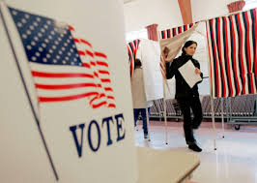
Uplift modeling (continued)
Uplift modeling starts with an A-B test of two treatments
In marketing, might be message A versus message B
In political campaigns, might be message versus no message

Slide 12

Uplift modeling (continued)
For each voter you now have two variables – response (0/1), and which message they got (A/B)

Slide 13

Uplift modeling (continued)
For each voter you now have two variables – response (0/1), and which message they got (A/B)
Now add demographic, marketing, and voting history info for each voter in sample.

Slide 14
Uplift modeling (continued)
For each voter you now have two variables – response (0/1), and which message they got (A/B)
Now add demographic, marketing, and voting history info for each voter in sample.
Fit a classification model (0/1 – respond or not), with all predictor variables, including which message was sent
Run the model for all voters twice
  With original data
  With message predictor reversed

Slide 15
Uplift modeling (continued)
You now have two propensity scores for each voter
  One as if they got message A
  One as if they got message B
Propensity for favorable response with B minus propensity with A is the uplift for B over A
Used in marketing to “microtarget” different marketing messages appropriately
In political campaigns, often used to determine which is better:
  Send a message
  Send no message

Slide 16
Uplift Modeling in JMP Pro
The general approach to uplift modeling described on the previous slides is referred to as the “Two Model” approach
In JMP Pro, uplift modeling is based on classification trees
  Classification trees find splits to optimize a prediction
  Uplift models find splits to maximize a treatment different, or “Uplift”

Slide 17
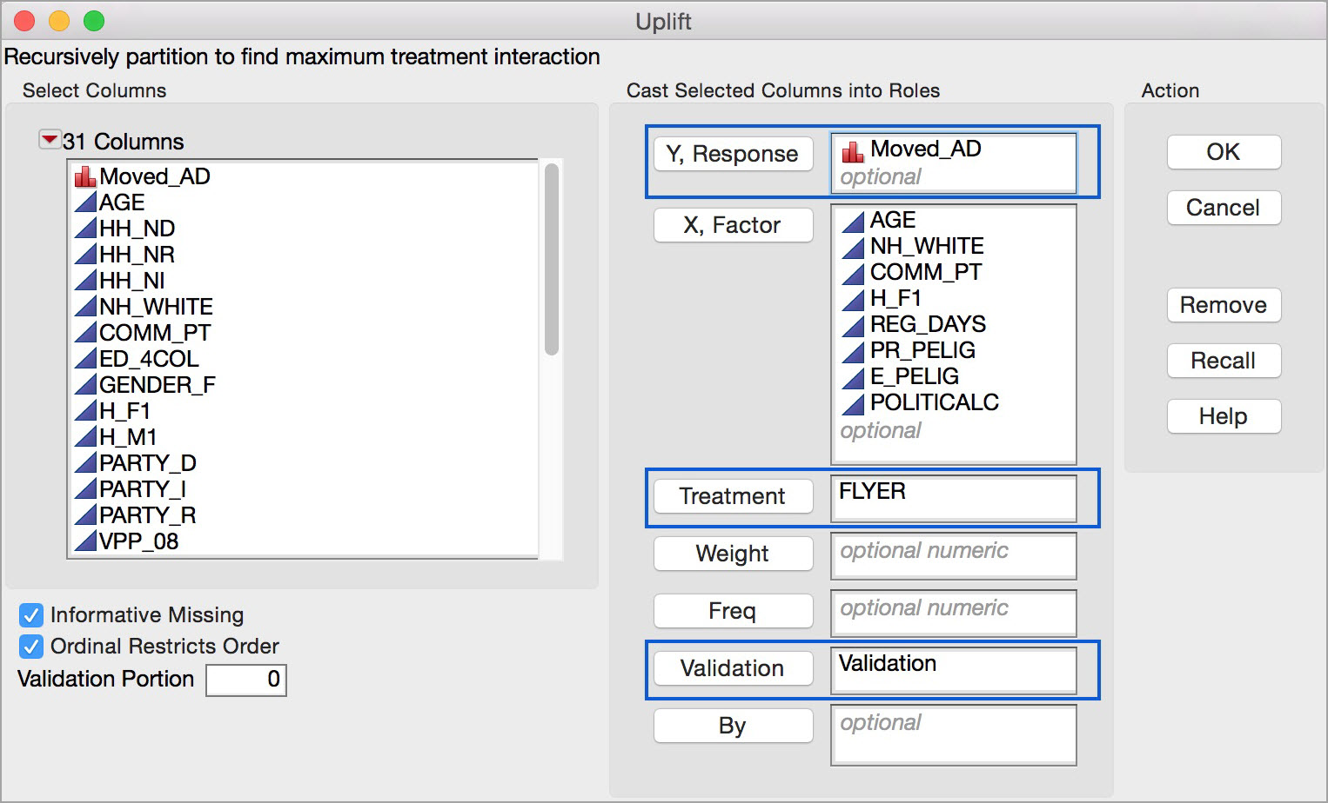
The JMP Uplift Dialog

Slide 18
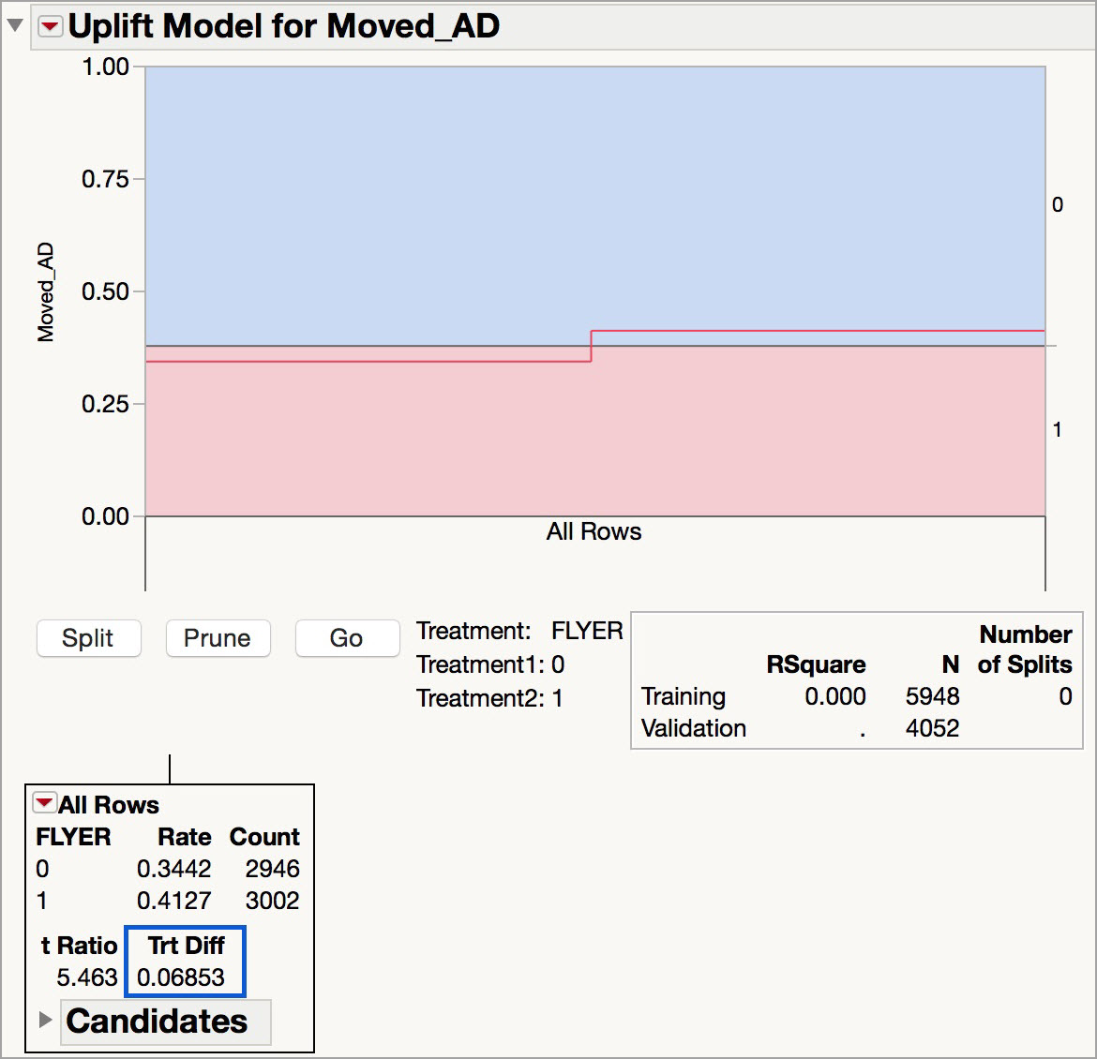
JMP Uplift Initial Output
Trt Diff is the Uplift – the treatment difference

Slide 19
Summary
Ensembles…
Generally perform better than individual models
Have many variants (averaging, weighted averaging, voting, medians, resampling)
Facilitate “parallel processing,” e.g. in contests where multiple teams’ models can be combined
Help mitigate overfitting (but do not cure it)
Are black-box – transparent methods like trees lose transparency when ensembled
Uplift models quantify the impact of a treatment (e.g. A-B testing)

